Slide 1
Edge-centric Computing: Vision and Challenge
Bîrlică Iulian-Ioan Petrescu Alina-Gabriela
Bîrzan Daniela

Slide 2
Overview
Edge-centric Computing (new paradigme)
Related fields
Research challenges
Scenarios

Slide 3
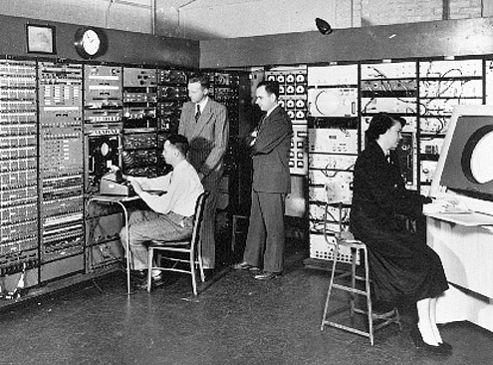
Decentralization wave
Centralization -> Decentralization
Decentralization -> Centralization
1980 -> new wave of decentralization

Slide 4
Centralization wave
Cloud Computing
High capacity mobile device
Decentralization -> Centralization
1980 -> new wave of decentralization

Slide 5
Fundamental problems (1)
Lost of privacy
E-commerce sites
Rating services
Search engines
Social network
Location services

Slide 6
Fundamental problems (2)
Unilateral trust from clients
Complete delegation of the application and systems control
Prevent establishing trust between users

Slide 7
Fundamental problems (3)
Missed opportunity of exploiting the personal modern devices
Communication
Computation
Storage

Slide 8
Fundamental problems (4)
Hampers novel human-centred design
Blurring the boundaries between man and machine

Slide 9
The need for a new wave of decentralization
Edge-centric Computing paradigme

Slide 10
Proximity is in the edge
Intelligence is in the edge
Trust is in the edge
Control is in the edge
Humans are in the edge

Slide 11
Public Spaces in the Edge
Smart Cities
Smart Grids
Smart Transportation Systems
IoT
IoE (Internet of Everything)

Slide 12
Public Spaces in the Edge
Efficency and Real-Time interactions
Fast responses to user or devices ➔ much more efficient without central intervention
IoE ➔ variety of heterogeneous mobile and fixed devices
Favors Edge-centric Computing hybrid architectures

Slide 13
Public Spaces / Trust and Control
A mobile User may switch devices between different service providers / sensors
Novel edge distributed technologies➔help perform threat analysis and protect
Trust mechanisms – make users active participants of the public space

Slide 14
Public Spaces / Humans
Are the most important factor
Ex: Goal of a Smart City – improve quality of life
Personalized advice
Bidirectional information Flow
Intelligent agents that would react according to user interests

Slide 15
Public Spaces / Proximity & Intelligence
Key characteristic = proximity to end-users, support for mobility
Huge amount of data from sensors in urban area
storing neighboring geospatial data in local edge servers

Slide 16
Conclusions
Novel paradigm, moves the locus of control to the edges of the network.
Edge=mobile device, wearable, nano-datacenter or a user-controlled device
allows users to retake control of their information

Slide 17
Conclusions
leveraging user’s resources
reducing response times
natural confluence of peer-to-peer and cloud computing ➔create hybrid architectures that combine stable resources with mobile terminals
overcomes the limitations of P2P models (churn, availability)
providing security and privacy to hybrid Edge services

